Slide 1
Opening a new restaurant in San Francisco
By
Manik Dhingra

Slide 2
Location of new restaurant important for entrepreneurs
Various factors involved in opening a new restaurant:
Visibility
Crime rates
Parking size
Surrounding business and competitor analysis
Data analysis of the above factors can help with decision making about the location of a new restaurant

Slide 3
Business Problem
To find the best possible location in San Francisco to benefit any future investors or restaurant owner

Slide 4
Data Acquisition and Cleaning
Data Sources
To get the data for the crime rate for the city of San Francisco, police department incident report from 2018 onwards was used from the following website: https://data.sfgov.org/Public-Safety/Police-Department-Incident-Reports-2018-to-Present/wg3w-h783
To get the data for geographical coordinates for various neighborhoods in San Fransisco, following website was used: https://data.sfgov.org/Geographic-Locations-and-Boundaries/Realtor-Neighborhoods/5gzd-g9ns/data

Slide 5
Data Acquisition and cleaning
Data for analysis of surrounding business and restaurants was extracted from FourSquare API: https://developer.foursquare.com/docs/api/venues/search
Geographical coordinates for showcasing the locations of the restaurants on the map was extracted from Geocoding API: https://developer.mapquest.com/documentation/geocoding-api/
Columns not needed from the crime rate dataframe were dropped
All the Null values were removed

Slide 6
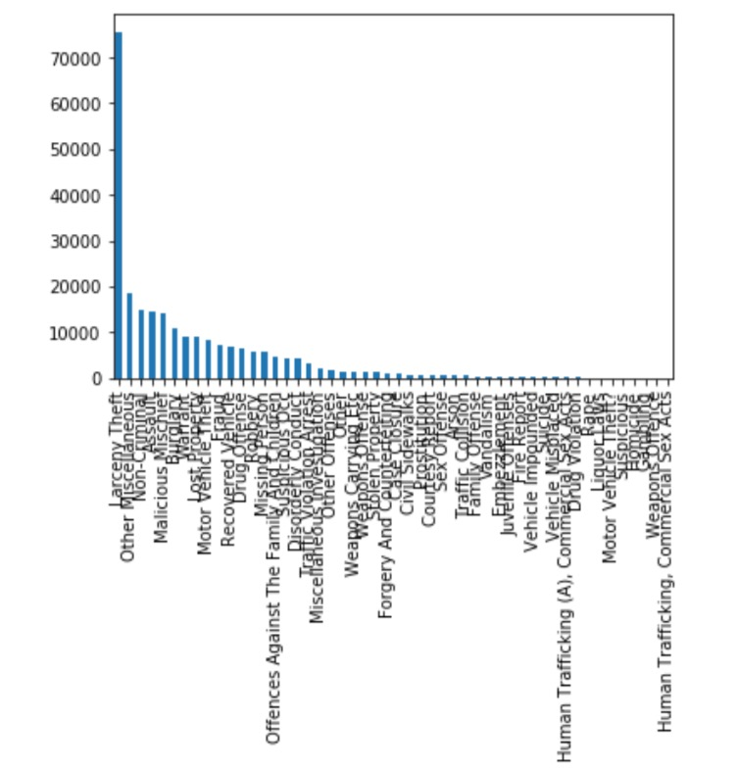
Frequency of each crime incident
Major contributors of the crime:
Larceny Theft,
Assault and
Burglary

Slide 7
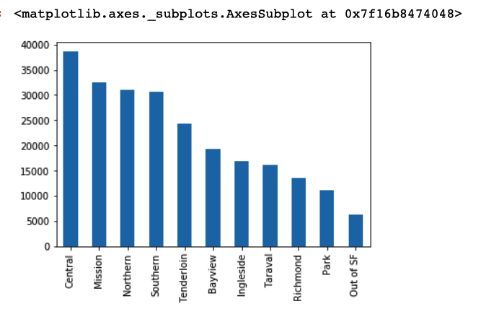
Distribution of Crimes by Police District

Slide 8
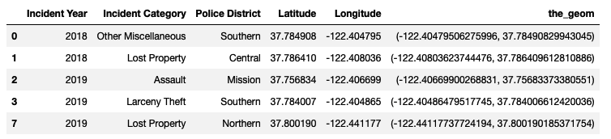
Neighborhood along with geographical coordinates

Slide 9
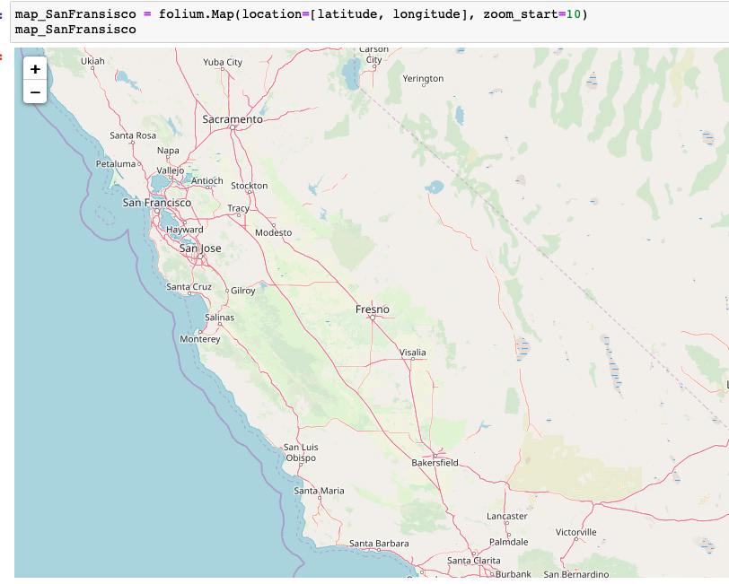
Map of San Francisco

Slide 10
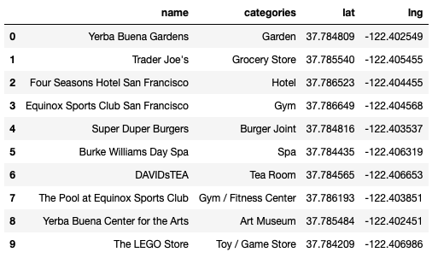
Venues in neighborhood along with geographical coordinates

Slide 11
Result and Conclusion
K-means algorithm used to form clusters and analyze to see most common venues in the neighborhoods of San Francisco.
Opening restaurant in North Beach might be a good idea due to overall low crime rate and looking at the map, it being closer to waterfront brings more foot and car traffic which in turns bring in good visibility.

